Slide 1
Representing Knowledge Using Rules

Slide 2
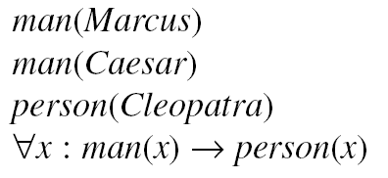

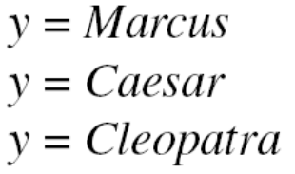
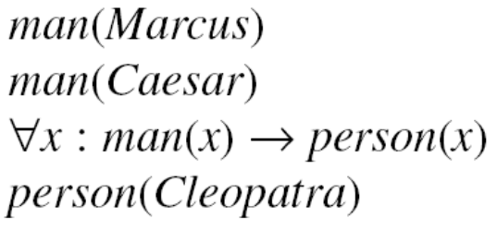
Procedural vs Declarative Knowledge
Procedural vs Declarative Knowledge
Consider the knowledge base :
Suppose we want to answer the question
We could answer with any one of :
Now consider an alternative KB

Slide 3


PROLOG
A PROLOG program is composed of a set of Horn clauses. A Horn Clause is a clause that has at most one positive literal.
Examples :

Slide 4
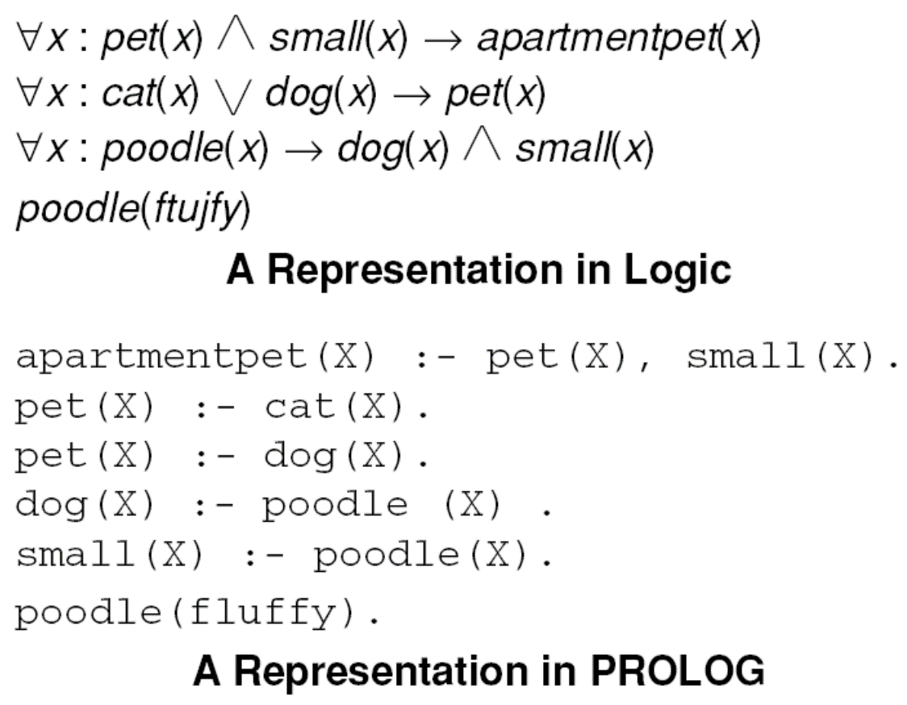
A Declarative and a Procedural Representation

Slide 5
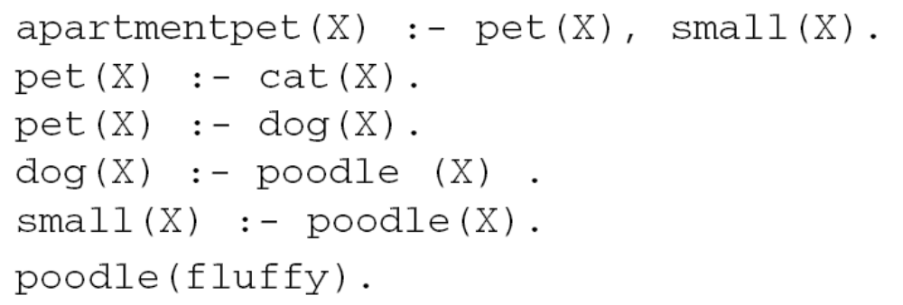
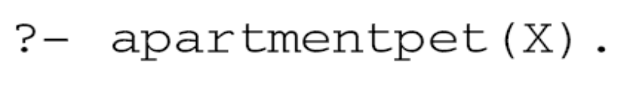
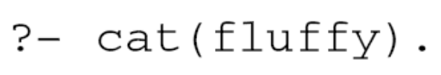

Answering Questions in PROLOG
(mittens)

Slide 6
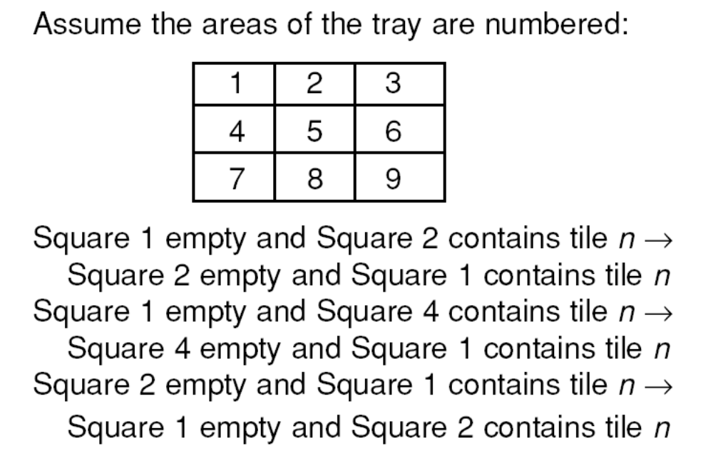
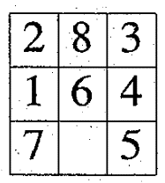
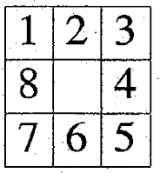
A Sample of the Rules for
Solving the 8-Puzzle
An Examples :
Start
Goal

Slide 7
Forward vs Backward Reasoning
Number of start and goal states.
Branching factor in each direction.
Need to justify reasoning.
Triggers for problem solving.

Slide 8
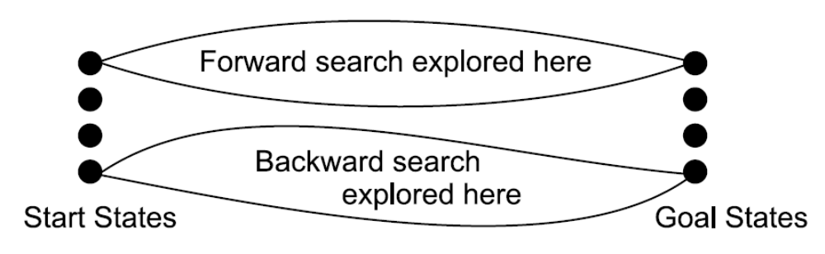
A Bad Use of Heuristic
Bidirectional Search

Slide 9
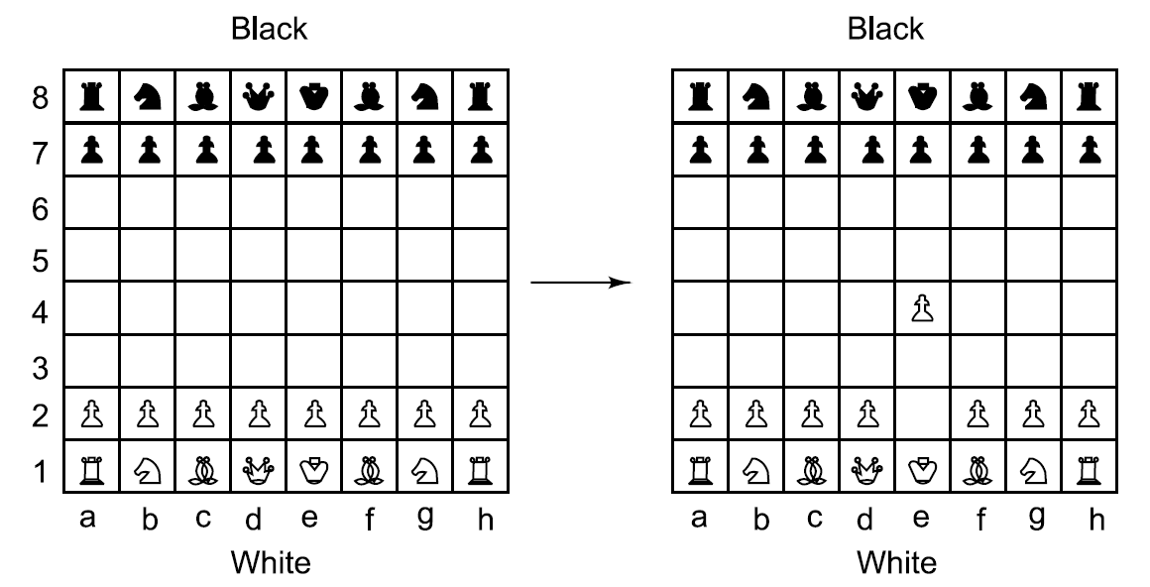
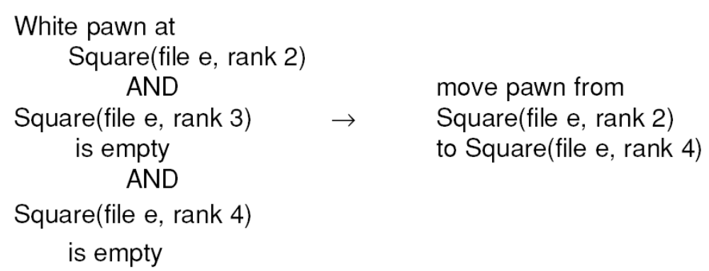
Representation Affects Matching

Slide 10
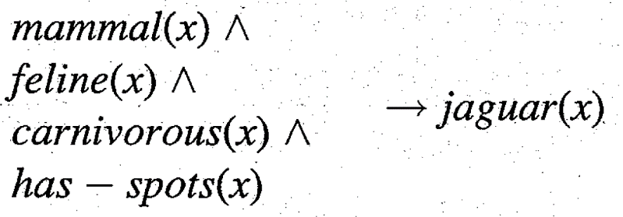
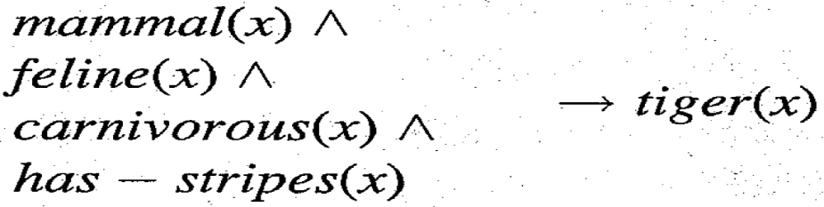
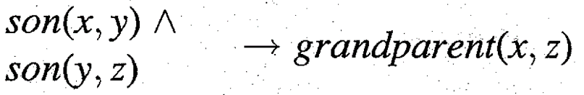
Many to Many Matching
The temporal nature of data.
Structural similarity in rules.
Persistence of variable binding consistency.

Slide 11
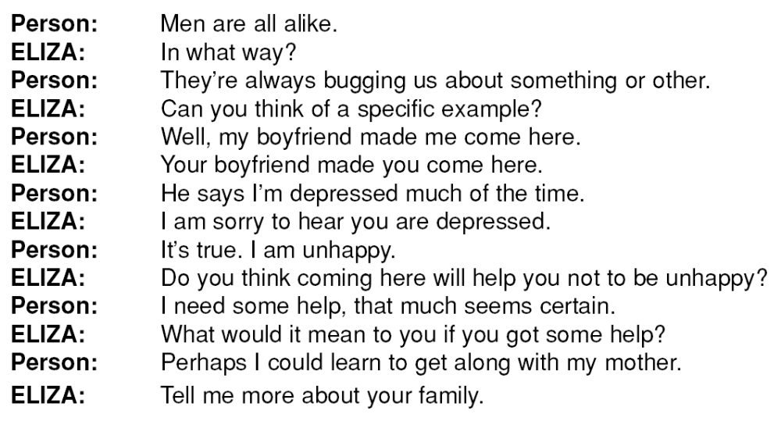
A Bit of a Dialogue with ELIZA

Slide 12
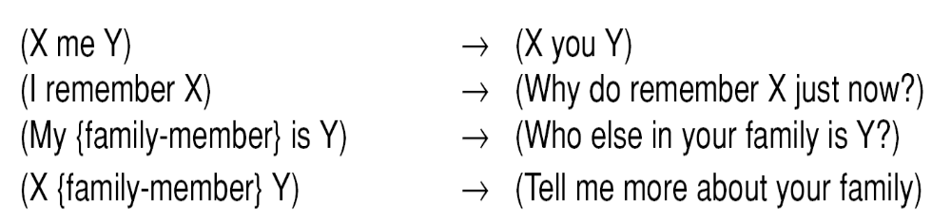
Some ELIZA-like rules

Slide 13
Conflict Resolution
Preferences based on rules.
  - Rule order.
  Prefer special cases over more general ones.
Preferences based on objects.
  - Prefer some objects to others.
  - Location in STM.
Preferences based on states.

Slide 14
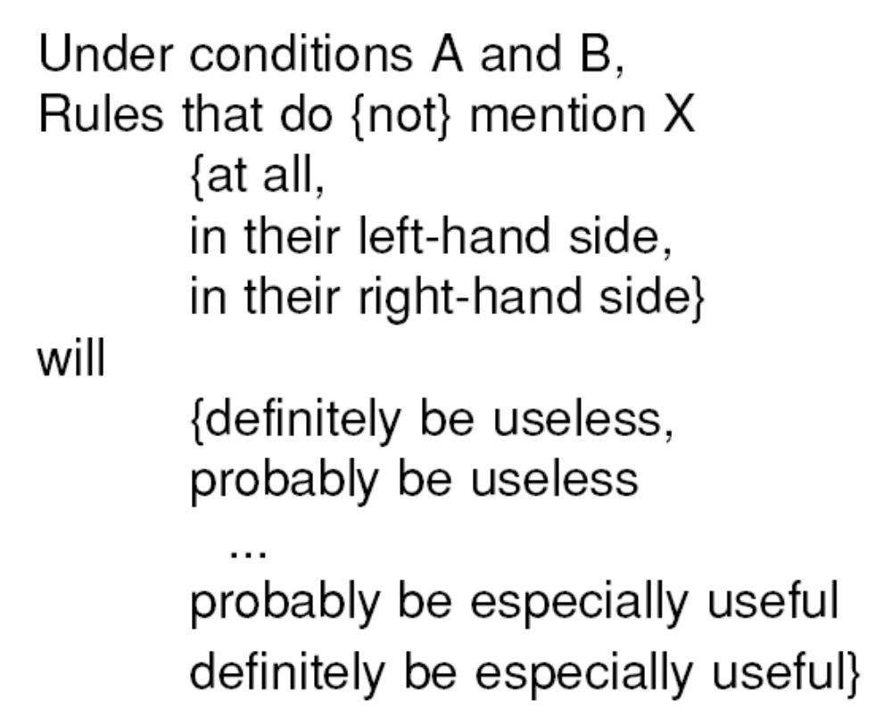
Syntax for a Control Rule

